Slide 1
Fresh Grads – Group Project
Hostel Management Application

Slide 2
Problem Statement
To Create a Web Application for Hostel Management Application
ADMIN
Admin will be responsible to manage the details of all the students, Wardens and room allotments. Like admin can a new user and view the list of existing users in the application.
Student/User
- Students can check their transaction and profile details.
Students can register and login to the application and manage
Wardens
- Wardens have access to add new visitors to the application.
- Wardens can manage the student details.
.

Slide 3
Road Map
Application will be developed in following Sprints –
Core Java +JPA with Hibernate
Spring Boot + Rest Controller + JPA with Hibernate
Angular for UI design (Front End) + Integration with previous Sprint

Slide 4
Plan
Design
Generate the skeleton as per class design provided
TDD approach
Identify test cases for each module
Write Failing Test cases
Convert the Test Cases in GREEN
Implement the case study in incremental manner

Slide 5
Modules
Login Module
Student Management
Warden Management
Hostel Management
Room Management
Visitor Management

Slide 6
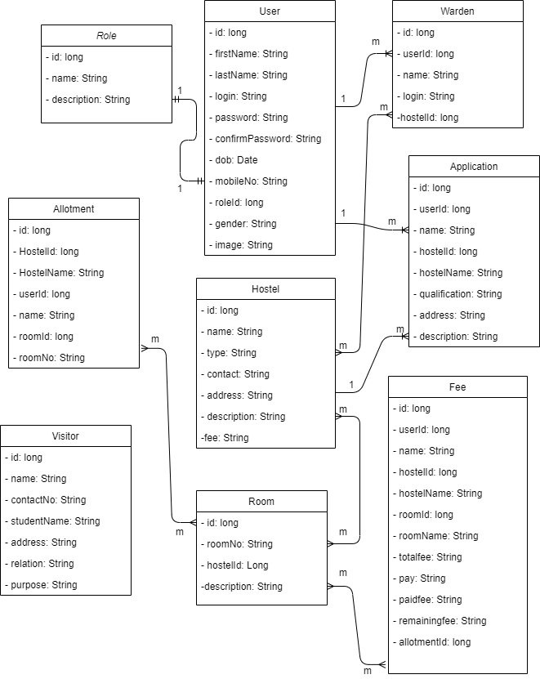
Class Design
POJO Classes:

Slide 7
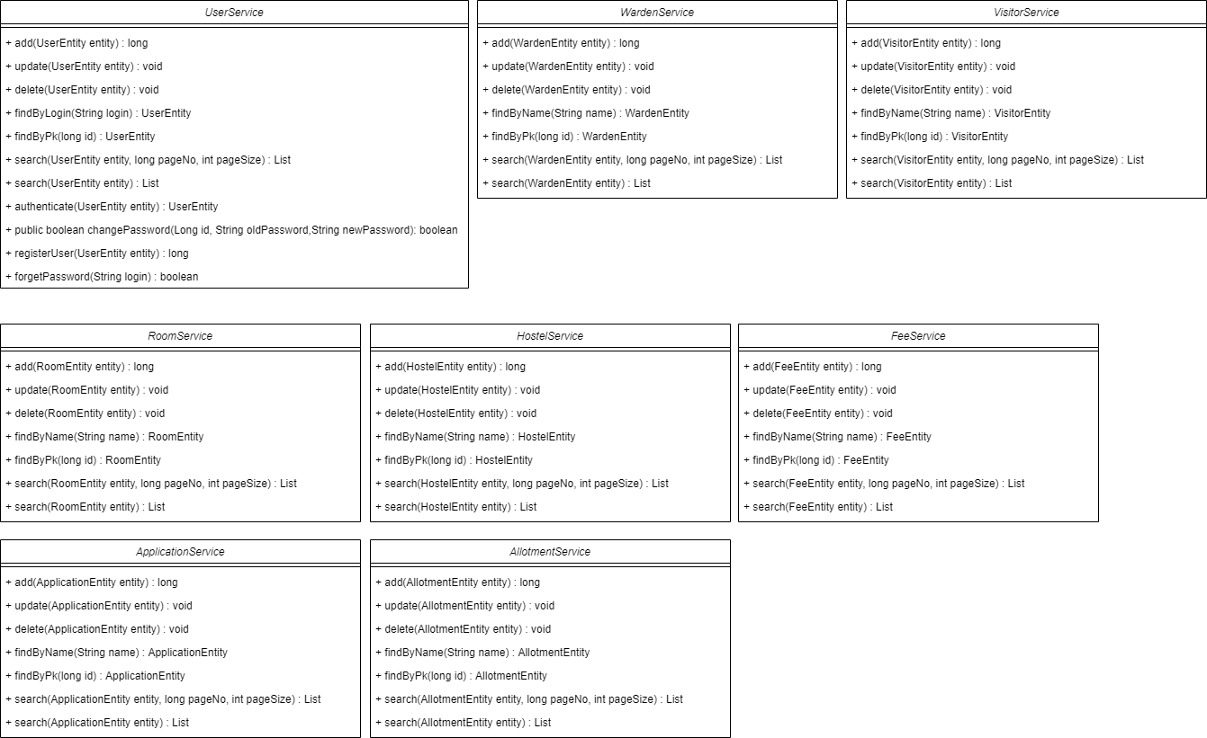
Class Design/Service Interface:

Slide 8
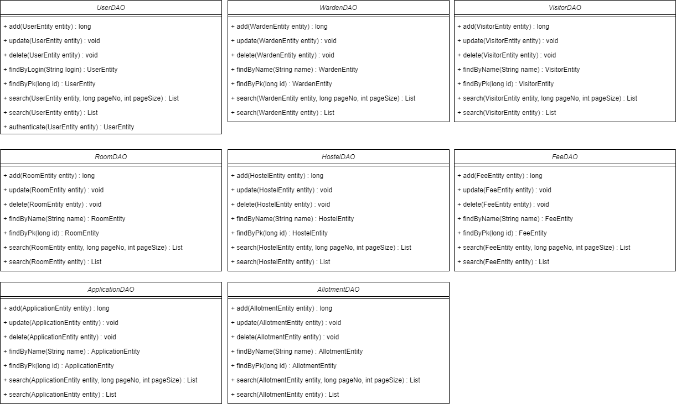
Class Design/ Repository

Slide 9




Questions

